Slide 1
ROBUST STOCHASTIC APPROXIMATION
APPROACH TO STOCHASTIC PROGRAMMING
Notes:
Uncle Luo is Handsome!!!

Slide 2
Two problems discussed:
stochastic optimization problem:
convex-concave stochastic saddle point problems

Slide 3
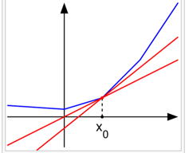
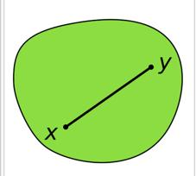
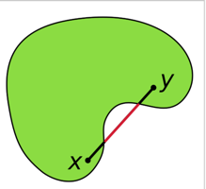
stochastic optimization problem:
x is a n dimension vector
X is a n dimension nonempty bounded closed convext set (x’s domain)
ξ is a d dimension random vector
Ξ is a d dimension vector set, ξ’s probabilty distribution P is supported on Ξ
support : P(ξ ∈ Ξ) > 0
F: X × Ξ -> R
Assume:
the expected value function f(x) is continuous and convex on X
not necessarily differentiable
Convex
Non-Convex
Non-differentiable at x₀
Notes:
Hello! Can you see me editting?

Slide 4
Solutions to the stochastic optimization problem:
the stochastic approximation (SA)
the sample average approximation (SAA)
people think SAA is better than SA
the proposed modified SA is competitive with SAA
Two assumptions:
possible to generate an independent identically distributed sample(iid sample) ξ₁, ξ₂,..., of ξ
an oracle existed: for a input point (x, ξ) ∈ X × Ξ returns G(x, ξ) such that g(x) := E[G(x, ξ)] ∈ ∂f(x) → subgradient of f(x)

Slide 5
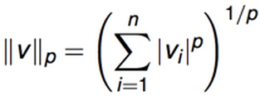
Notations
||x||_{p} denotes l_{p} norm
||x||₂ is the euclidean distance; ||x||∞ = max{|x₁|,..., |x_{n}|}
ΠX : the metric projection operator onto the set X
ξ_{[j−1]} = (ξ₁,...,ξ_{j−1}) : the history of the generated random process

Slide 6
SA Approach 1, Classical SA algorithm:
for chosen x₁ ∈ X and a sequence stepsize γ_{j} > 0, j = 1,... iterate like this:
problem left: decide stepsize γ_{j} ;
note: x* is the optimal x, A_{j} = 0.5|| x_{j} − x∗||²₂ , a_{j} = E[A_{j}] = 0.5E[|| x_{j} − x∗||²₂] .
with
and assume
solved by an oracle
x_{j+1}
x* ∈ X
(a-b)² = a²-2ab+b² ; a=(x_{j}-x*)
M > 0, we get:

Slide 7
Further assume: f(x) is differentiable and strongly convex on X, we have: there is constant c > 0 such that
strong convexity of f(x) implies that the minimizer x∗ is unique, then we have:
then we have

Slide 8
With
we have (x − x∗)^{T} g ≥ c||x − x∗||²₂ for all x ∈ X and g ∈ ∂f(x), follew by
combine with
we have:

Slide 9
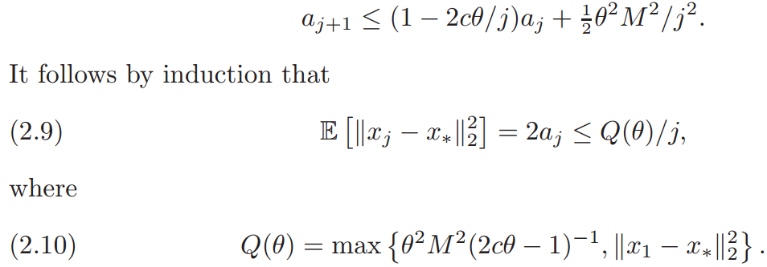
Back to the problem : decide the stepsize decide stepsize γ_{j}
Strategy: take stepsizes γ_{j} = θ/j for some constant θ > 1/(2c)
based on , we have:
expectation of distance square
Conclusion: after j iterations, converge rate in term of the distance to x∗ is O(j^{−1/2})

Slide 10
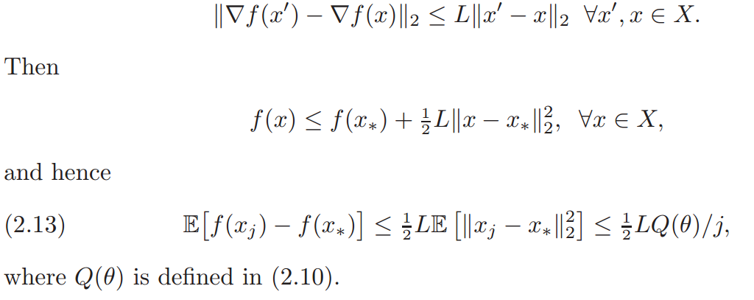
Futher assume:
x∗ is an interior point of X
∇f(x) is Lipschitz continuous, i.e.,
Conclusion: after j iterations, converge rate in term of objective value is O(j⁻¹)

Slide 11
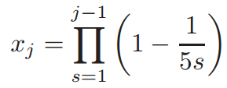
Observation: 1) the convegence speed is highly sensitive to a priori information on c
E.g. consider f(x) = x²/10, X = [−1, 1] ⊂ R, and G(x, ξ) ≡ ∇f(x). We start at point x₁ = 1, and set θ = 1/c
Case 1: overestimated c, by taking θ = 1 (i.e., γ_{j} = 1/j) -> c=1
after j = 10⁹ iterations, x^{j}>0.015 (optimal x*=0)
Case 2: lucky choice c=0.2, by taking θ = 5 (i.e., γ_{j} = 5/j) . then x_{j+1} = (1 - 1/j)x_{j}
x₂=0=x*, converge after first iteration
2) the stepsizes γ_{j} = θ/j may become completely unacceptable when f loses strong convexity.
E.g. consider f(x) = x⁴, X = [−1, 1] ⊂ R, and G(x, ξ) ≡ ∇f(x). with γ_{j} = θ/j and 0 < x₁ ≤ 1 /(6√θ)
i.e.

Slide 12
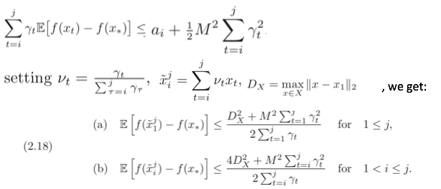
SA Approach 2, Robust SA approach (different stepsize strategy):
Assume convexity, we have:

Slide 13
Using a fixed stepsize:
Assume:
the number N of iterations of the method is fixed in advance
γ_{t} = γ > 0, t = 1,...,N.
minimize the right-hand side of we get:
We also have, for 1<= K <= N
Assume constant stepsize with parameter a constant θ > 0 , i.e.

Slide 14
Based on
Robust SA’s expected error in term of the objective value is O(N^{-1/2}), which is worse than the classic SA (O(N⁻¹))
Roubust SA only assumes convexity
the classic SA assumes:
smooth
strongly convex function
with domain which contains the minimum point x*
For Robust SA, no need to tune a fine stepsize (so called robust)

Slide 15
Using varying stepsizes:
Assume:
the number N of iterations of the method is not fixed
using stepsize
We have, for 1<= K <= N
setting K = ⌈ rN ⌉, with a fixed r ∈ (0,1),

Slide 16
Mirror descent SA (general lp norm):
Notation:
refer to the 2.2 Robust Euclidean SA as E-SA
∥ · ∥ be a (general) norm on R^{n}
-> a linear function space
a function ω : X → R is a distance-generating function modulus α > 0 with respect to ∥ · ∥ -> (ω is the f(x) in previous sections)
with assumptions:
ω is continously differentiabl and strongly convex with parameter α with respect to ∥ · ∥, i.e.
with similar deduction, we get:
where

Slide 17
begin from formula 2.41, assume that the method starts with the minimizer of ω
deduct further, we get:
Using a constant stepsize:
assuming the number N of iterations of the method is fixed in advance
γ_{t} = γ > 0, t = 1,...,N.
assume a constant parameter 𝞠 > 0, and the stepsize is

Slide 18
Analysis of deviations
assume a stronger inequation:
comparing to

Slide 19
Using varying stepsize
With similar deduction, we get, for 1<= K <= N,
minimize the right-hand side, we get a decreasing stepsize policy

Slide 20
Comparison between E-SA and M-SA
the same convegence speed: O(N^{-1/2}) in terms of the expected error of the objective
For E-SA,
For M-SA(l₁ norm),
Get a ratio:
Conclusion: under the example’s setting,
l₁ never is much worse than the l₂, b/c on the left-hand side, the ratio is related to
l₁ could ne far better than l₂, b/c on the right-hand side, the ratio is related to n

Slide 21
Comparison between M-SA and SSA
compare the required iteration numbers for M-SA and the required smaple size of SSA to reach
Conclusions:
both SA and SAA methods have logarithmic in δ and quadratic (or nearly so) in 1/ε complexity in terms of the corresponding sample sizes.
the SAA method requires solution of the corresponding (deterministic) problem
the SA approach is based on simple calculations as long as stochastic subgradients could be easily computed

Slide 22
Stochastic saddle point problem :
similar assumptions.
Mirror SA algorithm for saddle point problems
with similar assumptions and deduction, we get:
for constant stepsize approach:
For a fixed number of steps N,with the constant stepsize policy
for variable stepsize: , we have:
Notes:
Hello! Can you see me editting?

Slide 23
deviration analysis for varying stepsize
assume :
we have:

Slide 24
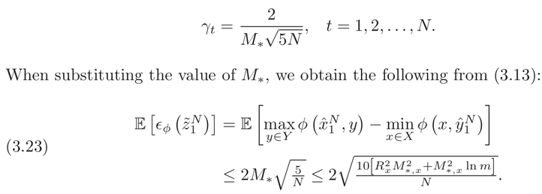
Application to minimax stochastic problems
Considering problem:
assume : the expected value functions f_{i}(·), i = 1,...,m, are well defined, finite valued, convex, and Lipschitz continuous on X and similar other assumptions. Then the problem equal to:
Using the constant stepsize policy, we get:
Conclusion: The error of the saddle point mirror SA algorithm in this case is “almost independent” of the number m of constraints (it grows as O(√lnm) as m increases)

Slide 25
Finally, let’s talk about the oracle: In order to obtain a realization G(x, y, ξ),one has to compute m random subgradients G_{i}(x, ξ), i = 1, . . . , m, and then their convex combination
The minimax stochastic problem can be treat as a stochastic descending problem with a randomized oracle

Slide 26
Application to bilinear matrix games
distance function:
already know:
using randomized oracle:
for expected error analysis:
for deviation analysis:

Slide 27
we have error bound after N iterations:
the total number of entries in A used in the course of the entire computation does not exceed

Slide 28
Conclusion
It introduces the Classic SA approach of solving stochastic optimization problem, and proves its objective function f(x)’s converge rate is O(t⁻¹), here t is iteration times.
It proposes a new Robust SA approach using Euclidean distance(l₂ norm) as its distance measure. Its converge rate is also O(t⁻¹). Howerver it has a more subtle way to decide stepsize comparing to the Classic SA, which doesn’t require tuning.
It proposes the Mirror descent SA which generalizes the Robust SA to l_{p} norm.
Note: the above three appoaches all require an oracle to provide sub-gradient.
4. It applies the Mirror descent SA approach to a new problem: saddle point problem. In this problem, it demostrate a way to implement the oracle.

Slide 29
Q&A
Yifang:
1. The first paper says Equation (5) is the Taylor expansion of batching learning. But I feel that it is both batch learning and online learning. Is it correct?
2. What does E in equation (6) of the first paper denote?
3. What is sub-gradient, defined on the page 1575 of the second paper?
for any x₀ in the domain of the function one can draw a line which goes through the point (x₀, f(x₀)) and which is everywhere either touching or below the graph of f. The slope of such a line is called a subderivative (used for undifferemtiable points, not smooth lines)

Slide 30
Q&A
Tavish:
From Large Scale Online Learning paper:
What is the difference between optimization and learning speed with respect to empirical cost C_n and expected cost C_{\infinity}?
Also, paper mentions that both batch and online sequences converge at the same speed for adequate choices of scaling matrix. Does it mean that both are equally fast? How does convergence speed relate to learning/optimization speed?
From ROBUST STOCHASTIC APPROXIMATION APPROACH TO STOCHASTIC PROGRAMMING:
3. I didn’t understand much of this paper. So to just get a high level idea of what is the gist behind the two methods that have been compared in the paper, can you briefly describe the stochastic approximation (SA) and the sample average approximation (SAA) method and highlight the major difference between the two?
In the classical analysis of the SA algorithm assumed that
f(·) is twice continuously differentiable
f(·) is strongly convex
the minimizer of f belongs to the interior of X
conclusions for SA:
rate of convergence E[f(x_{t})−f∗] = O(t⁻¹)
sensitive to a choice of the respective stepsizes
longer stepsizes were suggested with consequent averaging of the obtained iterates
For convex-concave saddle point problems, if assume:
general-type Lipschitz continuous convex objectives
conclusions for saddle point problems:
O(t ^{−1/2}) rate of convergence
This paper doesn’t focus on the SAA approach. Briefly, the SAA approach
generate a (random) sample ξ1,...,ξN , of size N, and approximate the “true” problem (1.1) by the sample average problem

Slide 31
Q&A
Brad:
1. re: Large Scale Online Learning - Is there any way to quantify the point where online algorithms become better? i.e. in terms of dataset size.
2. re: Stockastic Approzximation - Can you give an overview of the "Classical SA algorithm?"
problems: try to solve , and find the optimal x
solution: gradient descent, using iteration formular:
in j^{th} iteration, find a sub-gradient descending direction, and move r_{j} step size. r_{j} is setted as γ_{j} = θ/j
3. re: Stochastic Approximation - Does E-SA ever outperform N-SA in terms of quality of solutions?
Yes. E-SA and N-SA’s performace ratio satisfy this inequation: both equal signs can be meet

Slide 32
Q&A
Yuankai:
Questions for Stochastic Gradient Descent:
1. What is the contribution and importance of this paper?
2. As the paper argues that "an adequate online algorithm outperforms any batch algorithm during the final convergence phase as well”, so are there any situations that batch algorithm works better?
3. What is saddle point problem and stochastic saddle point problem?
stochastic saddle point problem:
saddle point problem is in the similar form but without random variable ξ

Slide 33
Brendan:
From "Large Scale Online Learning",
I'm having trouble understanding the scaling matrix Phi_k. It doesn't appear to allow much flexibility in the step-size since it's real-valued?
The authors mention "single sweep" as a major advantage of the online algorithm (the idea being that going to disk for the same piece of data repeatedly could get extremely costly), but how would a batch chosen to fit in main memory compare with an online algorithm given the same amount of runtime and how would the comparison change with scale?
From "Robust Stochastic Approximation Approach to Stochastic Programming",
Does "robust" refer strictly to the strongly convex vs. convex assumption? The results seem a little suspect since they chose a specific problem class and tailored the SA approach while using a general SAA-based algorithm.
No. Robust doesn’t mean convex assumption. It means this approach doesn’t need to tune stepsize. It has a formula to decide the stepsize.

Slide 34
Grace:
1) What is positive definite. What is positive semi-definite. What is mini-max.
2) bottou and Cun. When you do online gradient, whether the order of using which sample to process at time t matters? Will different order in the same batch will have different results? Does it matter?
3) For nemirovski et al., algorithms in 2.1, 2.2, 2.3, what are their differences? Show in details. Be concise.
It introduces the Classic SA approach of solving stochastic optimization problem, and proves its objective function f(x)’s converge rate is O(t⁻¹), here t is iteration times.
It proposes a new Robust SA approach using Euclidean distance(l₂ norm) as its distance measure. Its converge rate is also O(t⁻¹). Howerver it has a more subtle way to decide stepsize comparing to the Classic SA, which doesn’t require tuning.
It proposes the Mirror descent SA which generalizes the Robust SA to l_{p} norm.
4) nemirovski et al.. Can you find a demo for one algorithm in section 2, as well as one algorithm in section 3? otherwise, show graphical illustrations for them to illustrate the idea. Online demo will be the best.
E.g. consider f(x) = x²/10, X = [−1, 1] ⊂ R, and G(x, ξ) ≡ ∇f(x). We start at point x₁ = 1, and set θ = 1/c
Case 1: overestimated c, by taking θ = 1 (i.e., γ_{j} = 1/j) -> c=1
after j = 10⁹ iterations, x^{j}>0.015 (optimal x*=0)
Case 2: lucky choice c=0.2, by taking θ = 5 (i.e., γ_{j} = 5/j) . then x_{j+1} = (1 - 1/j)x_{j}
x₂=0=x*, converge after first iteration

Slide 35
reference pages

Slide 36
stochastic optimization problem:
x is a n dimension vector (is x a vector of random variables?)
X is a n dimension nonempty bounded closed convext set (x’s domain)
ξ is a d dimension random vector
Ξ is a d dimension vector set, ξ’s probabilty distribution P is supported on Ξ
F: X × Ξ -> R
ps:
- the support of a function is the set of points where the function is not zero-valued
- Let S be a vector space over the real numbers, or, more generally, some ordered field. This includes Euclidean spaces. A set C in S is said to be convex if, for all x and y in C and all t in the interval [0, 1], the point (1 − t)x + ty also belongs to C
-Close set: For a set closed under an operation
- A set S is bounded if it has both upper and lower bounds

Slide 37
stochastic subgradient
for any x₀ in the domain of the function one can draw a line which goes through the point (x₀, f(x₀)) and which is everywhere either touching or below the graph of f. The slope of such a line is called a subderivative (used for undifferemtiable points, not smooth lines)

Slide 38
Previous Work
In the classical analysis of the SA algorithm assumed that
f(·) is twice continuously differentiable
f(·) is strongly convex
the minimizer of f belongs to the interior of X
conclusions for SA:
rate of convergence E[f(x_{t})−f∗] = O(t⁻¹)
sensitive to a choice of the respective stepsizes
longer stepsizes were suggested with consequent averaging of the obtained iterates
For convex-concave saddle point problems, if assume:
general-type Lipschitz continuous convex objectives
conclusions for saddle point problems:
O(t ^{−1/2}) rate of convergence

Slide 39
Previous Work
The SAA approach
generate a (random) sample ξ1,...,ξN , of size N, and approximate the “true” problem (1.1) by the sample average problem

Slide 40
http://www.doc.ic.ac.uk/~ae/papers/lecture03.pdf

Slide 41
Compactness
Compactness: In mathematics, and more specifically in general topology, compactness is a property that generalizes the notion of a subset of Euclidean space being closed (that is, containing all its limit points) and bounded (that is, having all its points lie within some fixed distance of each other).

