Slide 1
Differential privacy and how it compares with legal standards of privacy Kobbi Nissim Georgetown University The growing ubiquity of algorithms in society: implications, impacts and innovations [Royal Society, London, October 2017]

Slide 2
computer scientist
1

Slide 3
What is a computation? A computational task?
What can/cannot be computed?
Quantify resources needed in computation:
Time, space, communication, randomness, …
Algorithms
Computation
Algorithms with special properties:
Learning, privacy, fairness, transparency/accountability, Incentive compatibility, …
computer scientist
1

Slide 4
What is a computation? A computational task?
What can/cannot be computed?
Quantify resources needed in computation:
Time, space, communication, randomness, …
Algorithms
Computation
Algorithms with special properties:
Learning, privacy, fairness, transparency/accountability, Incentive compatibility, …
computer scientist
Growing ubiquity of algorithms in society: part of social interactions, decision making, legal system, economic systems, research, etc.
1

Slide 5
What is a computation? A computational task?
What can/cannot be computed?
Quantify resources needed in computation:
Time, space, communication, randomness, …
Algorithms
Computation
Algorithms with special properties:
Learning, privacy, fairness, transparency/accountability, Incentive compatibility, …
Is
privacy?
computer scientist
Growing ubiquity of algorithms in society: part of social interactions, decision making, legal system, economic systems, research, etc.
1

Slide 6
Help policy makers avoid unrealistic views of privacy, understand tradeoffs
Is privacy privacy?
Help technologists come up with the ‘right’ privacy solutions
Reasoning should combine technical and social aspects of privacy
2

Slide 7
Talk plan
Differential privacy: a technical privacy definition
Is differential privacy privacy?
3

Slide 8
Talk plan
Differential privacy: a technical privacy definition
FERPA: a legal privacy standard
Does differential privacy satisfy FERPA?
3

Slide 9
Differential privacy
4

Slide 10
Data privacy: the problem
Scientific
findings
Collection of personal Data
New business applications
Analysis
(Computation)
Outcome
Policy making
National security
Can we compute and release functions of the dataset while protecting individual privacy?
5

Slide 11
Attacks on SDL techniques
Re-identification [Sweeney ’00, …]
GIC data, health data, clinical trial data, DNA, Pharmacy data, text data, registry information, …
Blatant non-privacy [Dinur, Nissim ‘03], …
Auditors [Kenthapadi, Mishra, Nissim ’05]
AOL Debacle ‘06
Genome-Wide association studies (GWAS) [Homer et al. ’08]
Netflix award [Narayanan, Shmatikov ‘09]
Social networks [Backstrom, Dwork, Kleinberg ‘11]
Genetic research studies [Gymrek, McGuire, Golan, Halperin, Erlich ‘11]
Microtargeted advertising [Korolova 11]
Recommendation Systems [Calandrino, Kiltzer, Naryanan, Felten, Shmatikov 11]
Israeli CBS [Mukatren, Nissim, Salman, Tromer ’14]
Attack on statistical aggregates [Homer et al.’08] [Dwork, Smith, Steinke, Vadhan ‘15]
Slide idea stolen shamelessly from Or Sheffet
5

Slide 12
Differential privacy
A new line of privacy work in theoretical computer science (beginning ~2003).
Yields new concept: Differential Privacy (2006).
Rich theory.
In first stages of implementation and real-world use.
6

Slide 13
Differential privacy is a mathematical definition of privacy
It expresses a specific desiderata of an analysis (computation):
Any information-related risk to a person should not change significantly as a result of that person’s information being included, or not, in the analysis.
7

Slide 14
A privacy desiderata
Real world:
My ideal world:
Data
Analysis
(Computation)
Kobbi’s data
Outcome
same outcome
Data
w/my info removed
Analysis
(Computation)
Outcome
8

Slide 15
A privacy desiderata
Real world:
☺’s ideal world:
Data
Analysis
(Computation)
No Utility!
Outcome
same outcome
Data
w/☺’s info removed
Analysis
(Computation)
Outcome
8

Slide 16
A realistic privacy desiderata
Real world:
☺’s ideal world:
Data
Analysis
(Computation)
Outcome
$ε$-”similar”
same outcome
Data
w/☺’s info removed
Analysis
(Computation)
Outcome
8

Slide 17
Differential privacy [Dwork McSherry Nissim Smith ‘06]
Real world:
☺’s ideal world:
Data
Analysis
(Computation)
Outcome
Chance of any bad event almost the same in everybody’s ideal and real worlds
$ε$-”similar”
Data
w/☺’s info removed
Analysis
(Computation)
Outcome
8

Slide 18
Differential privacy [Dwork McSherry Nissim Smith ‘06]
$M:X^{n}→T$ satisfies $ε$-differential privacy if $∀x,x^{′}∈X^{n}$ s.t. $dist_{H}\left(x,x^{′}\right)=1$, $∀S⊆T$,
$\underset{M}{Pr}\left[M\left(x\right)∈S\right]≤e^{ε}\underset{M}{Pr}\left[M\left(x^{′}\right)∈S\right]$.
9

Slide 19
Interpreting differential privacy
DP is parameterized. Smaller 𝜀 means better privacy.
Allows bounding privacy loss of a combination of analyses via composition theorems.
“Automatic” opt-out: I am protected (almost) as if my info is not used at all.
Plausible deniability: I can claim any value for my information as outcome is (almost) as likely with that value.
I incur limited risk: Contributing my real info can increase the probability I will be denied insurance by at most 1%.
When compared with not participating, or contributing fake info.
10

Slide 20
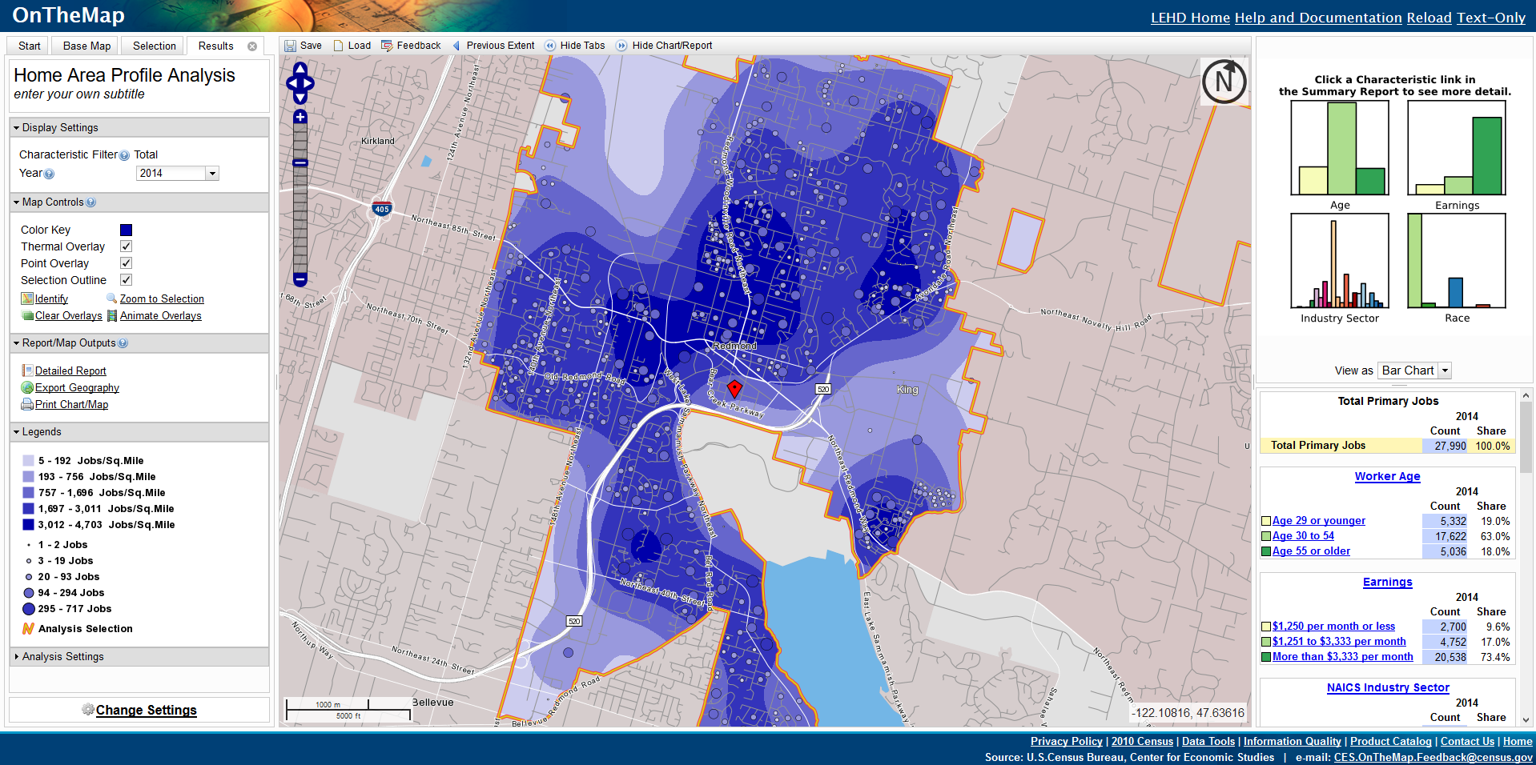
U.S. Census Bureau (2008 AD)
http://onthemap.ces.census.gov
11
Notes:
Launched in 2006, OnTheMap is an application that offers visualizations of household and employee concentrations. Starting in 2006, the application employs Differential Privacy to generate a synthetic dataset describing household concentrations for employees. The first map in the slide represents the concentration of employee households for the city or Redmond, WA. The darker the blue, the greater the number of workers that live in the corresponding area (this is the data that is generated using differential privacy). For comparison, the second map presents a visualization of where jobs are located. The darkest area at the bottom left of the city is the area where Microsoft is located. Graphs and tables on the right side of either image break down the worker population in the area by age, earnings, industry sector and race (scrolling down on that right-side panel we can see the explanation of what each color means). Explanations for Age and earnings graphs can be seen in the slide. For industry sector, not surprisingly, the largest bar represents the “Information” sector and the second largest bar corresponds to “Professional, Scientific and Technical Services.” For race, the largest bar is “White Alone” and the second largest bar is “Asian.”
The viewer may wonder why it is necessary to generate synthetic data to present a visualization where jobs and households are so closely packed. The answer is that most areas in the map do not have as high a concentration of jobs and, in such cases, it would be easy to identify specific households.

Slide 21
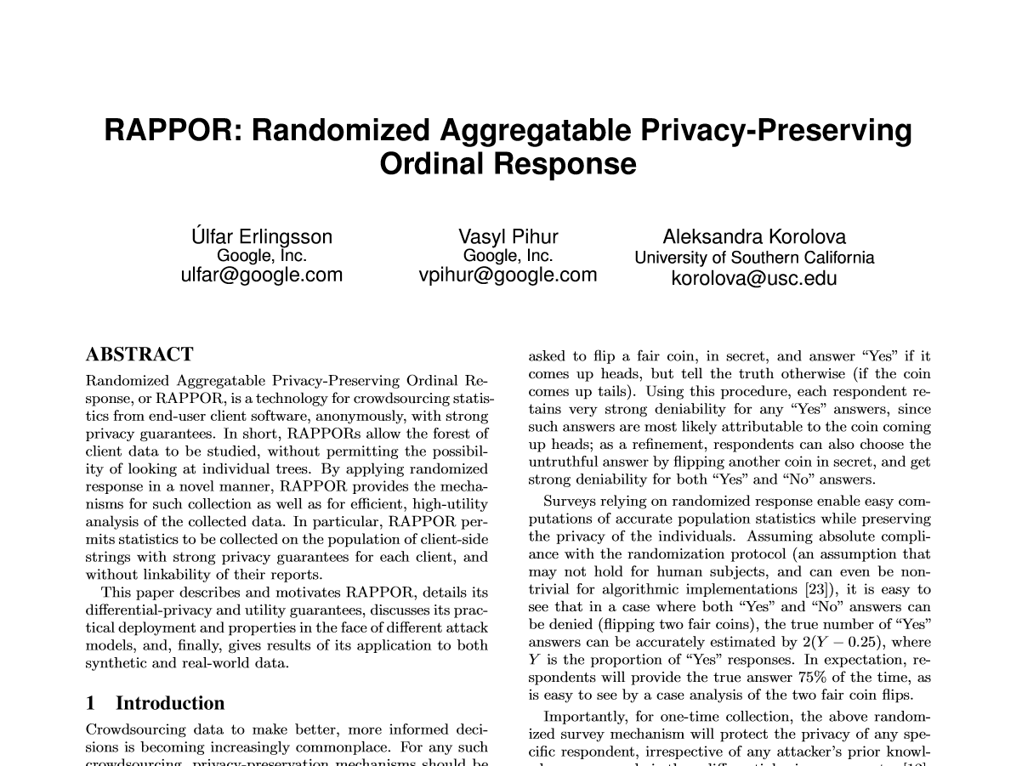
GOOGLE (2014 AD)
12
Notes:
Add date

Slide 22
Apple (2016 AD)
13

Slide 23
FERPA
14

Slide 24
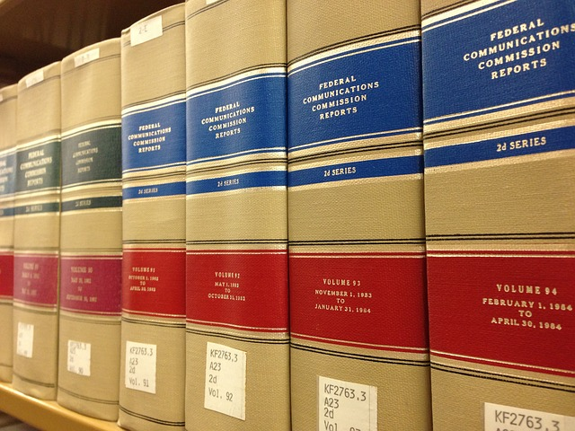
Introduction to FERPA
Family Educational Rights and Privacy Act of 1974. Governs the disclosure of personal information contained in education records
Our interpretation is derived from multiple sources:
The text of the statute (20 U.S.C. 1232g)
The implementing regulations (34 C.F.R. Part 99), which are typically what we are referring to when we cite FERPA
The 2008 final rule amending the FERPA regulations, especially the preamble discussion (the “Preamble”)
Guidance documents from the Department of Education’s Privacy Technical Assistance Center
15
Notes:
FERPA is lengthy and complex, we only illuminate a few points

Slide 25
FERPA: directory vs. non-directory information
Directory information: Information from education records that can be made public; is designated by each school (34 C.F.R. § 99.37)
Examples include names, addresses, telephone numbers, photographs, dates and places of birth, degrees, honors, awards . . .
Non-directory Personally Identifiable Information: Information contained in education records that can only be disclosed without consent under certain exceptions (34 C.F.R. § 99.31)
16

Slide 26
What/whom does FERPA protect against?
FERPA’s definition of PII (and “attacker”):
“information that, alone or in combination, is linked or linkable to a specific student that would allow a reasonable person in the school community, who does not have personal knowledge of the relevant circumstances, to identify the student with reasonable certainty”
(34 C.F.R. § 99.3)
Objective standard: a “hypothetical, rational, prudent, average individual”
Standard based on the knowledge of a member of the school community (stronger than one based on the knowledge of any reasonable person)
17

Slide 27
Some points of mismatch
FERPA*
Differential Privacy
Highly sector- and context-specific
Endorses de-identification, no guidance w.r.t. other techniques
Refers to the obvious extreme cases, not to more difficult “gray areas”
Not rigorous/formal from a technical standpoint
Generic
Does not endorse a specific technique; gives clear guidance w.r.t. all techniques
Does not leave “gray areas”.
A mathematically rigorous definition
* Other laws (e.g., HIPAA) share these characteristics
18
Notes:
HIPAA: Health Insurance Portability and Accountability Act (HIPAA) Privacy Rule

Slide 28
But how can we bridge these very different languages?
$M:X^{n}→T$ satisfies $ε$-differential privacy if $∀x,x^{′}∈X^{n}$ s.t. $dist_{H}\left(x,x^{′}\right)=1$ $∀S⊆T$,
$\underset{M}{Pr}\left[M\left(x\right)∈S\right]≤e^{ε}\underset{M}{Pr}\left[M\left(x^{′}\right)∈S\right]$.
19

Slide 29
Arguing that differential privacy satisfies FERPA
20

Slide 30
A CS view of the legal definitions
BAD!
copy input to output
redact this
Good?
analyses
it depends...
21

Slide 31
A CS view of the legal definitions
BAD!
copy input to output
redact this
Good?
analyses
it depends...
21

Slide 32
A CS view of the legal definitions
BAD!
copy input to output
redact this
Good?
analyses
it depends...
21

Slide 33
DP satisfies one interpretation of FERPA DP satisfies other interpretations!
We have a problem!
22

Slide 34
Our methodology in a picture
BAD!
copy input to output
DP
redact this
Good?
analyses
23

Slide 35
A glimpse of the analysis
24

Slide 36
Bridging FERPA and DP
Main argument:
Use of differentially private analyses satisfies the requirements of FERPA
Main components:
We extract a mathematical definition of privacy from FERPA.
We provide a mathematical proof that DP satisfies this definition.

Slide 37
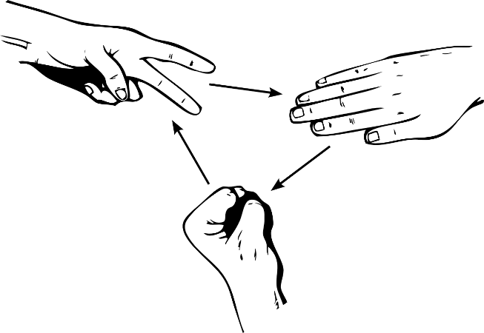
CS Paradigm of security definitions
Security/privacy defined as a game with an attacker (aka adversary)
Attacker defined by:
Computational resources it can spend
Knowledge it can bring from “outside the system”
Not uniquely specified: a large family of potential attackers
To capture all plausible attackers
Game defines:
Access to the system
What it means for an attacker to win
System secure/private:
If no attacker can win “too much”
26

Slide 38
Towards a FERPA security game
What is the attacker’s computational power?
What is in the directory and non-dir student info?
What external information does the attacker have?
dir
Student info
dir
Student info
dir
Computation result
Attempts to identify a student
What does “identify a student” mean technically?
Attacker wins if identification successful
How much winning is “too much” (i.e. a privacy breach)?
27

Slide 39
Principle: Err on the conservative side of law
Ambitious goal: Show that DP satisfies every reasonable interpretation of FERPA
How? Strengthen the attacker!
Whenever regulation is ambiguous let the attacker decide on its interpretation
Example: let attacker choose what’s in directory/non- directory information
Proving privacy w.r.t. such an attacker → proving privacy w.r.t. any reasonable interpretations of the regulation!
Thank you so much …
28

Slide 40
Is privacy privacy?
We need to know!
New paradigms needed for matching technical and legal/phylosophical definitions of privacy/fairness/etc.
Our modest attempt:
An argument of sufficiency: a combined mathematical-legal formal claim that differential privacy suffices for satisfying FERPA.
Extracting a formal (very conservative) attacker model from FERPA.
Dealing with ambiguity.
Mathematical proof that use of DP suffices for the resulting attacker model.
Not an argument of equivalence (in particular, not an argument for necessity).
29

Slide 41
Resources
Available on the Privacy Tools Project’s website:
Differential Privacy: A Primer for a Non-technical Audience (Preliminary Version) [K. Nissim, T. Steinke, A. Wood, M. Altman, A. Bembenek, M. Bun, M. Gaboardi, D. O'Brien, and S. Vadhan, 2017] Differential privacy and FERPA:
Bridging the Gap between Computer Science and Legal Approaches to Privacy. [K. Nissim, A. Bembenek, A. Wood, M Bun, M Gaboardi, U. Gasser, D. O'Brien, T. Steinke, and S. Vadhan, 2016]
30

Slide 42
Thank you
Beasts contributing to this project:
Center for Research on Computation and Society (CRCS), Harvard:
Kobbi Nissim, Aaron Bembenek, Mark Bun, Marco Gaboardi, Thomas Steinke, and Salil Vadhan
Berkman-Klein Center for Internet & Society, Harvard:
David O’Brien, Alexandra Wood, and Urs Gasser
31

