Slide 1
Nonparametric Regression
COSC 878 Doctoral Seminar
Georgetown University
Presenters:
Sicong Zhang,
Jiyun Luo.
April 14, 2015
Notes:
linear classification

Slide 2
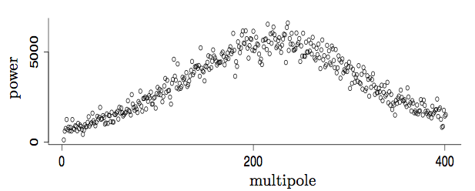
5.0 Nonparametric Regression

Slide 3
5.0 Nonparametric Regression
Definitions
We are given n pairs of observations (x₁, Y₁), . . . , (x_{n}, Y_{n}). The response variable Y is related to the covariate x by the equations
where r is the regression function. The variable x is also called a
feature. We want to estimate (or “learn”) the function r under weak
assumptions. The estimator of r(x) is denoted by . We also refer
to as a smoother.
we are treating the covariate values x_{i} as fixed in (5.1). We could instead treat these as random and r(x) is then interpreted as the mean of Y conditional on X = x, that is,

Slide 4
Questions: Parametric vs. Nonparametric
Q: What is the relation between parametric and nonparametric estimators? How are these estimators used in regression? (Yuankai)
Q: Can you compare parametric and non-parametric regression by providing mathematical formulae that shows the difference? (Tavish)
Q: Can you explain parametric vs. non-parametric regression in a broad sense? e.g., when should one be considered for use over the other? (Brad)
Q: What makes the methods non-parametric as opposed to parametric? Are there reasons to pick one over the other or are they just different classes of techniques for the same problems? (Henry)
Q: Non-parametric regression seems most useful when the data has high dimensionality (making it hard to intuit an appropriate form for the predictor), but Section 5.12 suggests that it doesn't scale well with dimensionality. What types of data of are these methods best suited for? (Brendan)

Slide 5
Answers: Parametric vs. Nonparametric
Nonparametric regression differs from parametric regression in that the shape of the functional relationships between the response (dependent) and the explanatory (independent) variables are not predetermined but can be adjusted to capture unusual or unexpected features of the data.
When the relationship between the response and explanatory variables is known, parametric regression models should be used.
If the relationship is unknown and nonlinear, nonparametric regression models should be used.
Here to learn more: Online short course from VirginiaTech <Parametric versus Semi/nonparametric Regression Models> http://www.lisa.stat.vt.edu/?q=node/7517

Slide 6
5.1 Review of Linear and Logistic Regression
Linear Regression

Slide 7
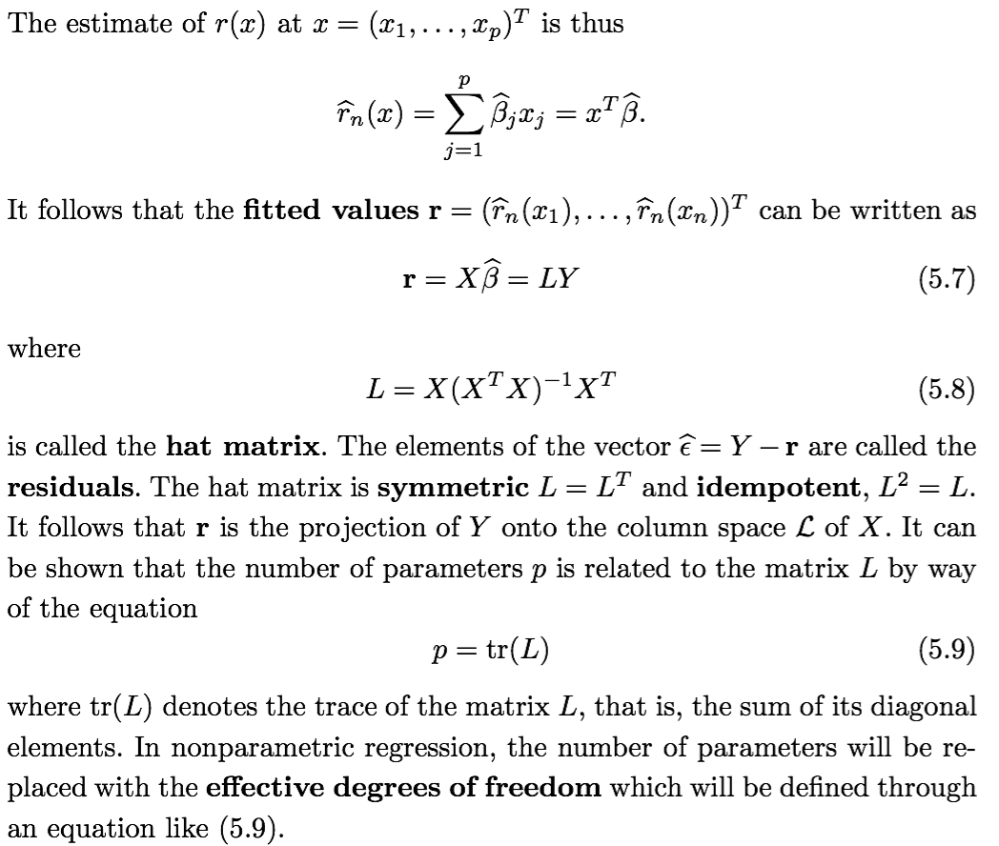
5.1 Review of Linear and Logistic Regression
Linear Regression

Slide 8
5.1 Questions:
Q: Are "effective degrees of freedom" the number of input dimensions that significantly effect the output? I don't understand the relationship between p and tr(L) in Equation (5.9). (Brendan)
A: Effective degrees of freedom is used in nonparametric regression. It should not be directly defined by individual input dimensions, otherwise it will be parametric regression. It really depends on the data.
For linear models, the trace of the hat matrix is equal to the rank of X, which is the number of independent parameters of the linear model. For other models the hat matrix can be used to define the effective degrees of freedom of the model.

Slide 9
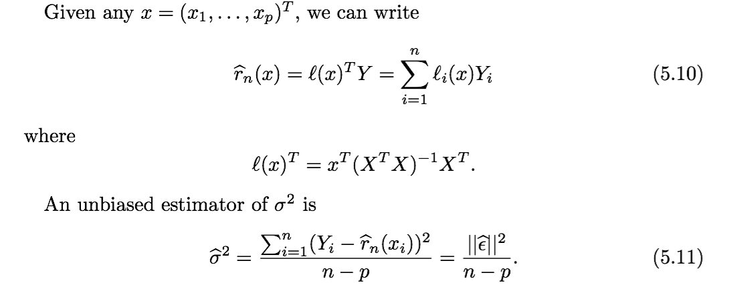
5.1 Review of Linear and Logistic Regression
Q: Could you explain the unbiased estimator (equation 5.11)? (Henry)
A: The bias of an estimator is the difference between this estimator's expected value and the true value of the parameter being estimated. An estimator or decision rule with zero bias is called unbiased. E(epsilon)=0.

Slide 10
5.1 Review of Linear and Logistic Regression
Linear Regression
Next, we construct a confidence band for r(x). We want to find a pair of function a(x), b(x) such that

Slide 11
Questions: Equation (5.12) and Confidence Band
Q: Can you explain what is a confidence band, and how is it used? It appears in equation 5.12. (Yuankai)
Q: Equation 5.12 defines an equation for confidence band. What is the purpose of confidence band and how does it relate to parametric and non-parametric regression? (Tavish)
A: A confidence band is used in statistical analysis to represent the uncertainty in an estimate of a curve or function based on limited or noisy data.
Confidence bands are closely related to confidence intervals, which represent the uncertainty in an estimate of a single numerical value. "As confidence intervals, by construction, only refer to a single point, they are narrower (at this point) than a confidence band which is supposed to hold simultaneously at many points."

Slide 12
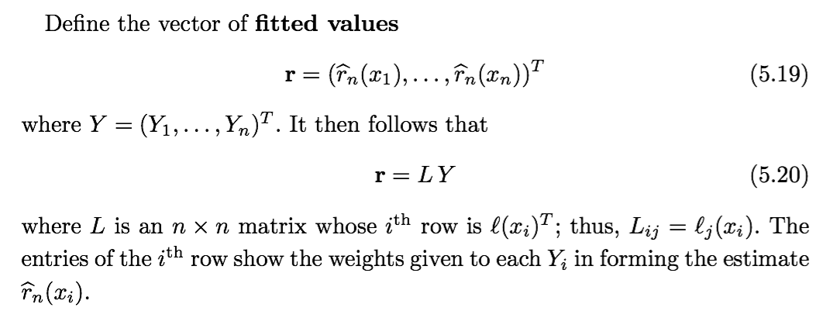
5.2 Linear Smoothers

Slide 13
5.2 Linear Smoothers

Slide 14
5.2 Questions:
Q: What is a kernel estimator? (Brad)
A: In statistics, kernel density estimation (KDE) is a non-parametric way to estimate the probability density function of a random variable. Kernel density estimation is a fundamental data smoothing problem where inferences about the population are made, based on a finite data sample.
More information about kernel estimator can be found in Chapter 6 of this textbook (NP).

Slide 15
5.3 Choosing the Smoothing Parameter
Risk (mean squared error)
Training error (average residual sums of squares)
Ideally, we would like to choose h to minimize R(h) but R(h) depends on the unknown function r(x). Instead, we will minimize an estimate
of R(h).
As a first guess, we might use the average residual sums of squares, also called the training error, to estimate R(h)

Slide 16
5.3 Choosing the Smoothing Parameter

Slide 17
5.3 Questions:
Q: Can you write out the algorithm (with loops) to calculate Formula 5.35 for Theorem 5.34? (Grace)
A: Actually this may be pretty straightforward. We can just sum the square terms together by one loop. (Blackboard.)

Slide 18
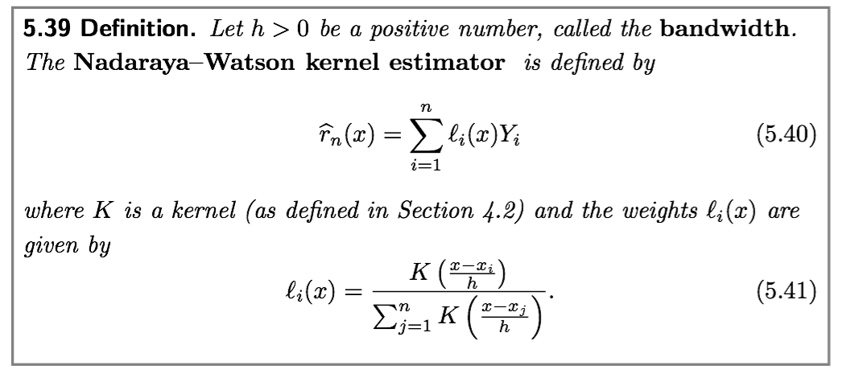
5.4 Local Regression
Local nonparametric regression
Suppose that is scalar and consider the regression model (5.1). In this section we consider estimators of r(x) obtained by taking a weighted average of the giving higher weight to those points near x. We begin with the kernel regression estimator.

Slide 19
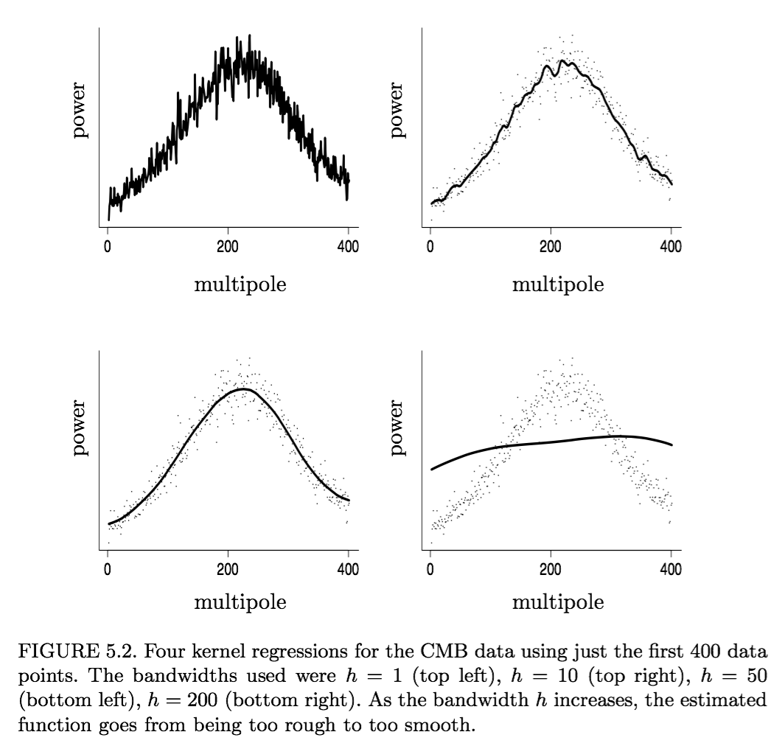
5.4 Local Regression

Slide 20
5.4 Questions:
Q: I'm having trouble parsing Equation (5.45). Can you point out the bias and variance terms and comment on the weighting (if there is any)? (Brendan)
Q: Page 73 says “The first term in (5.45) is the squared bias and the second term is the variance”. Could you explain it a bit further? (Yifang)

Slide 21
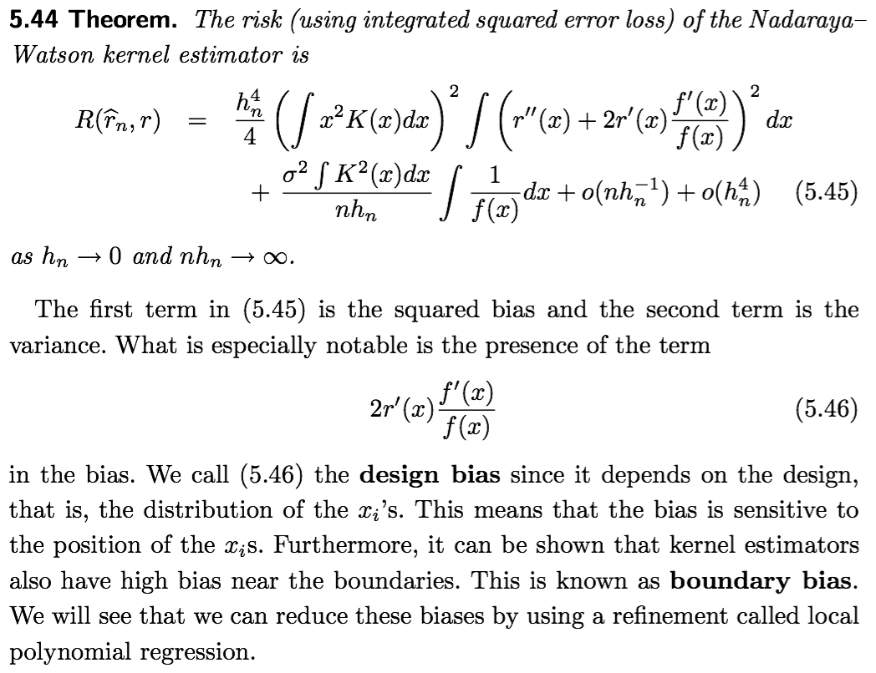
5.4 Local Regression

Slide 22
5.5 Penalized Regression, Regularization and Splines
Q: How is a roughness penalty determined? (Brad)
A: It actually depends on your choice. Any function that results in better results could be the roughness penalty. For example, Cubic splines are the most common splines used in practice.

Slide 23
5.5 Penalized Regression, Regularization and Splines

Slide 24
5.5 Questions:
Q: Both penalized regression and splines are used to smooth the regression functions. How are they related? Is splines one type of penalized regression? (Yuankai)
A: The penalized regression is a framework to minimize the penalized sums of squares defined in 5.70. A spline is a special piecewise polynomial. By using spline, we can do the penalized regression. Spline(a polynomial) is not one type of penalized regression(a framework). Spline is more like a tool that can be used to do the penalized regression.

Slide 25
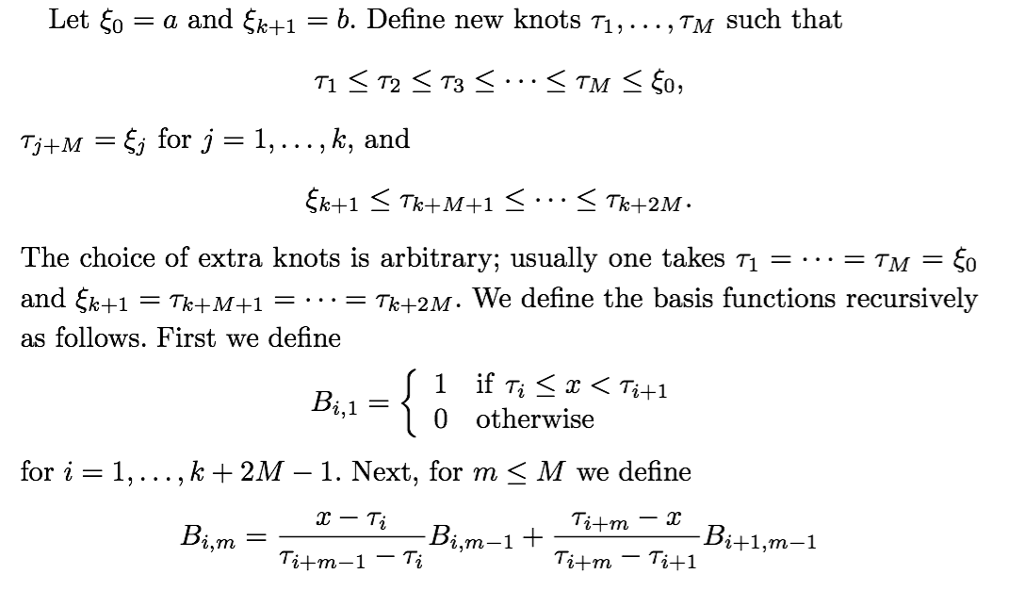
5.5 Penalized Regression, Regularization and Splines
We now introduce a different basis for the set of natural splines called the B-spline basis that is particularly well suited for computation. These are defined as follows.

Slide 26
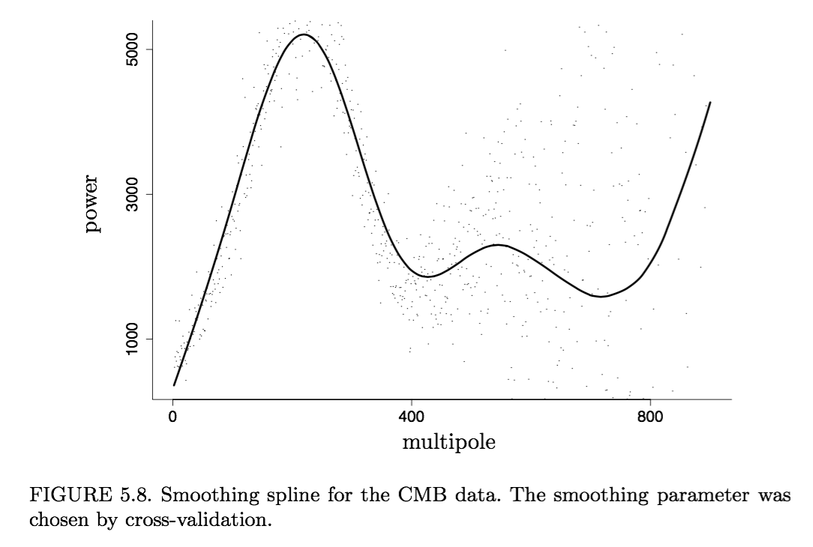
5.5 Penalized Regression, Regularization and Splines

Slide 27
Questions:
Q: What will be good b-splines for the graph in figure 5.8? (Grace)
A: My understanding is, b and other parameters for the splines all belongs to the “smoothing parameters”. In figure 5.8, they are chosen by cross-validation.

Slide 28
5.6 Variance Estimation
Let’s consider several methods for estimating σ².

Slide 29
5.6 Variance Estimation
Variance Function Estimation
Estimate r(x) with any nonparametric method to get an estimate
Define
Regress the ’s on the ’s (again using any nonparametric method) to get an estimate of and let
Q: I didn’t understand the variance estimation in section 5.6. Can you please explain that and also its significance? (Tavish)
A: By estimating , we can evaluate how good our regression is.

Slide 30
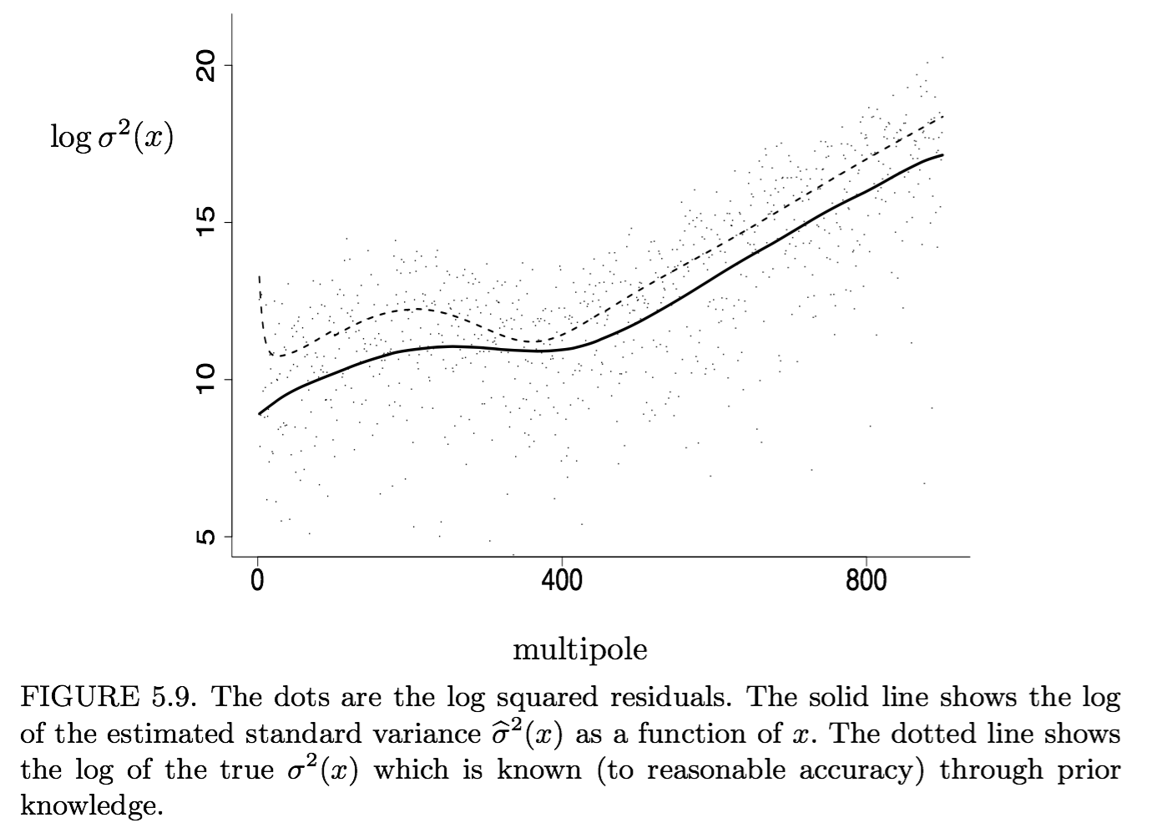
5.6 Variance Estimation
Variance Function Estimation
Estimate r(x) with any nonparametric method to get an estimate
Define
Regress the ’s on the ’s (again using any nonparametric method) to get an estimate of and let

Slide 31
Questions:
Q: Work out 5.91 and below it. (Grace)
The intuition of this estimator is that it is the average of the residuals that result from fitting a line to the first and third point of each consecutive triple of design points.
Notes:
Delta is the difference at Yi.

Slide 32
5.7 Confidence Bands
Construct confidence bands for r(x).
Typically these bands are of the form
where se(x) is an estimate of the standard deviation of and c > 0 is some constant. Before we proceed, we discuss a pernicious problem that arises whenever we do smoothing, namely, the bias problem.
The BIAS PROBLEM
Confidence bands like those we mentioned, are not really confidence bands for r(x), rather, they are confidence bands for which you can think of as a smoothed version of r(x).

Slide 33
5.8 Average Coverage
One might argue that requiring bands to cover the function at all x is too stringent.
Wahba (1983), Nychka (1988) and Cummins et al. (2001) introduced a different type of coverage that we refer to as average coverage.
Here we discuss a method for constructing average coverage bands based on an idea in Juditsky and Lambert-Lacroix (2003)
Suppose we are estimating r(x) over the interval [0,1]. Define the average coverage of a band (l,u) by
In Chapters 7 & 8, we present methods for constructing confidence balls for r. These are sets of the form
such that
Given such a confidence ball, let
These bands have average coverage at least

Slide 34
5.9 Summary of Linear Smoothing
Choose a smoothing method such as local polynomial, spline, etc. This amounts to choosing the form of the weights
Choose the bandwidth h by cross-validation
Estimate the variance function as described in Section 5.6
Find κ₀ from (5.101) and find c from (5.102).
An approximate 1 − α confidence band for is

Slide 35
5.10 Local Likelihood and Exponential Families
If Y is not real valued or is not Gaussian, then the basic regression model does not work well. Let’s discuss nonparametric regression for more general models.
Recall that Y has an exponential family distribution, given x, if
for some functions a(·),b(·) and c(·,·). Here, θ(·) is called the canonical parameter and φ is called the dispersion parameter. It then follows that
The usual parametric form of this model is for some known function g called the link function.
The following model is called a generalized linear model

Slide 36
5.11 Scale-Space Smoothing
There is another approach to smoothing championed by Chaudhuri and Marron (1999) and Chaudhuri and Marron (2000) called scale-space smoothing that eschews the idea of selecting a single bandwidth.
Let denote an estimator using bandwidth h. The idea is to regard as an estimator of . But rather than choosing a single bandwidth, we examine over a set of bandwidths h as a way of exploring the scale-space surface
where X is the range of x and H is the range of h.

Slide 37
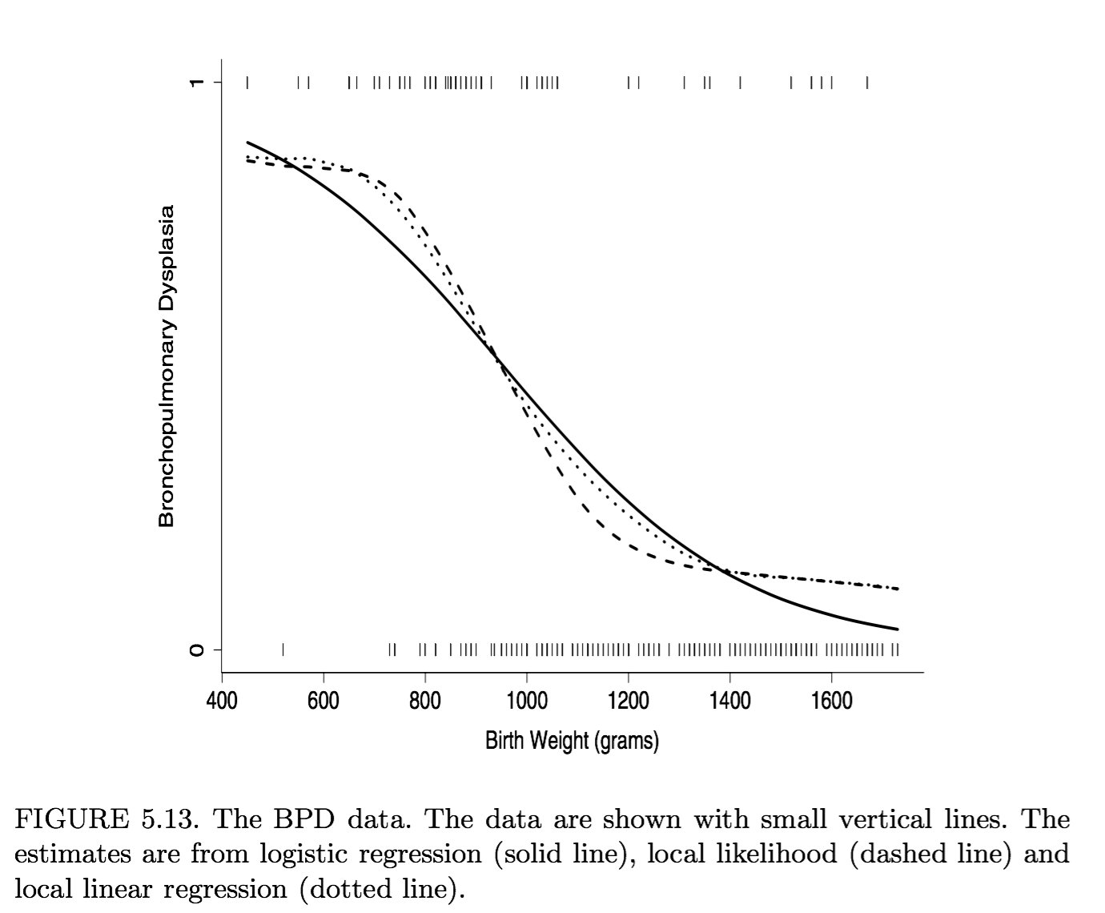
5.11 Scale-Space Smoothing

Slide 38
5.12 Multiple Regression
Q: What is multiple regression? (Yifang).
A: Multiple regression is an extension of simple linear regression. It is used when we want to predict the value of a variable based on the value of two or more other variables.
Suppose now that the covariate is d-dimensional,
The regression equation takes the form
A Fact: To maintain a given degree of accuracy of an estimator, the sample size must increase exponentially with the dimension d.

Slide 39
5.12 Multiple Regression
Local Regression
The kernel function K is now a function of d variables. Given a nonsingular positive definite d × d bandwidth matrix H, we define
Often, one scales each covariate to have the same mean and variance and then we use the kernel
where K is any one-dimensional kernel.

Slide 40
5.12 Multiple Regression
Splines
If we take a spline approach, we need to define splines in higher dimensions. For d = 2 we minimize
where
The minimizer r_{n} is called a thin-plate spline. It is hard to describe and even harder (but certainly not impossible) to fit.

Slide 41
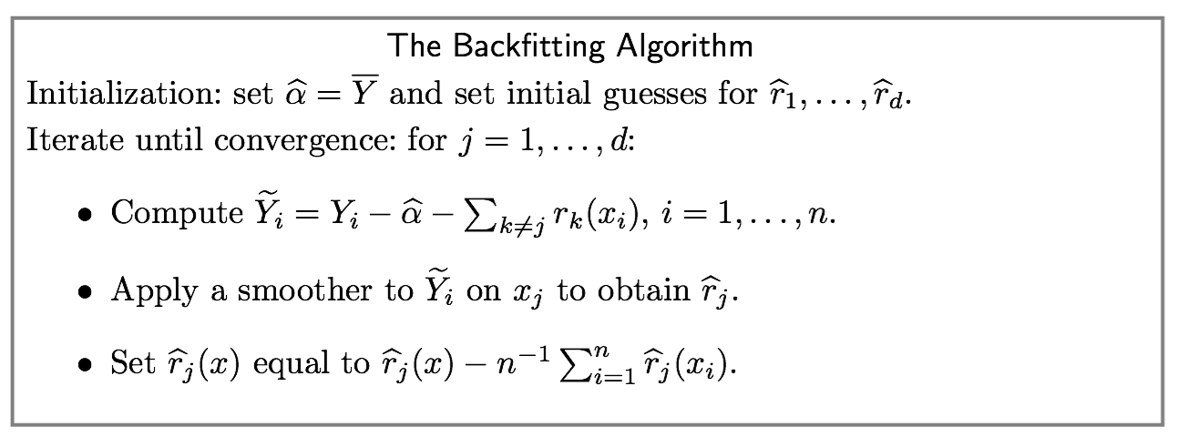
5.12 Multiple Regression
The Backfitting Algorithm:

Slide 42
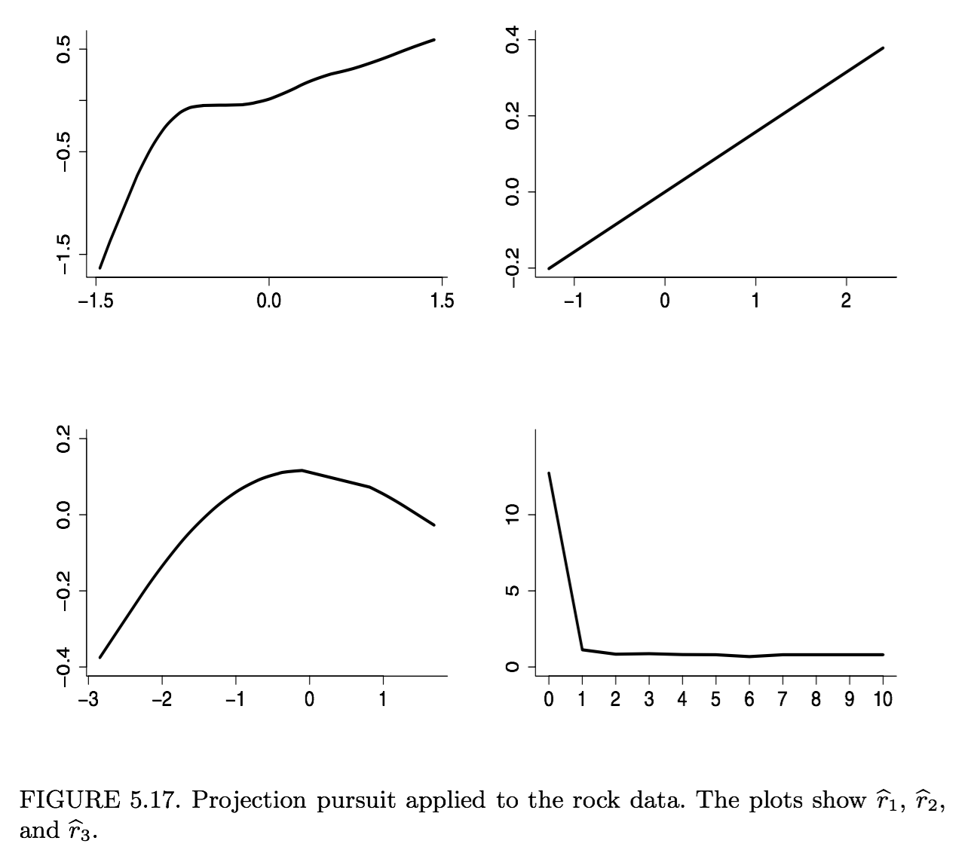
5.12 Multiple Regression
Projection Pursuit
Friedman and Stuetzle (1981) introduced another method for dealing with high-dimensional regression called projection pursuit regression. As each projection is found, the data are reduced by removing the component along that projection, and the process is repeated to find new projections。

Slide 43
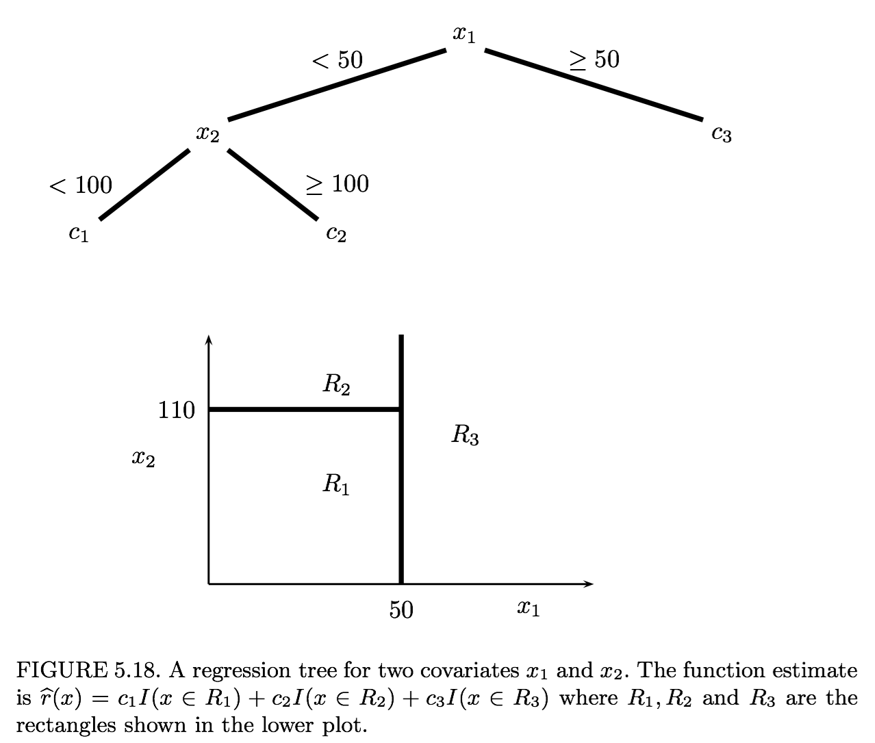
5.12 Multiple Regression
Regression Trees
Tree models were introduced by Morgan and Sonquist (1963) and Breiman et al. (1984). The model is fitted in a recursive manner that can be represented as a tree.

Slide 44
Thanks.

