Slide 1
Local Likelihood & other models, Kernel Density Estimation & Classification, Radial Basis Functions

Slide 2
Local Likelihood and Other Models
Other parametric models can be made local
Any such model that supports observation weights is easily adapted.

Slide 3
Local Likelihood and Other Models
Example: Likelihood
The probability of the parameters fitting the data, as opposed to the other way around
[Wikipedia]

Slide 4
Local Likelihood and Other Models
Example: Likelihood
Notes:
The likelihood model: There is this useful parameter theta, linear in the covariate(s) x_i. This here is

Slide 5
Local Likelihood and Other Models
Example: Likelihood
Notes:
Inference for Beta is based on the log likelihood in the first line.
We can model this using the likelihood local to x_0, for inference of theta(x_0), being x_0 transpose beta(x_0)
In the second line, we weight by our kernel function (Klambdax0xi)

Slide 6
Local Likelihood and Other Models
Example: Likelihood
Many likelihood models involve the covariates in a linear fashion.
This lets you take advantage of this while only requiring local linearity of the model.
Notes:
The reason this is useful is…

Slide 7
Local Likelihood and Other Models
Example: Log Likelihood
Notes:
multiclass linear logistic regression model (4.36) of Chapter 4. the linear model has the form here.

Slide 8
Local Likelihood and Other Models
Example: Log Likelihood
Notes:
N is still the N nearest neighbors, Kernel function evaluated with respect to x_0
Added the kernel function, summed it for 1 to N for all the neighbors, took the log of numerator and denominator (became subtraction) and turned all cases of B^Tx and made them B^T(xi-x0)
The difference between this and the previous is the log, obviously (next page)

Slide 9
Local Likelihood and Other Models
Example: Log Likelihood
Log is monotonically increasing
Same local max/min etc as original function
Often Easier to find these maximas from log likelihood

Slide 10
What are the differences among density estimation, classification, and regression? What are the uses of kernels in each of them? (-Grace)
What is Kernel density? (-Yifang)

Slide 11
Kernel Density Estimation and Classification
Notes:
N(x_0) is a small metric neighborhood around x_ of width lambda
This is bumpy, for similar reasons as bumpy functions decribed earlier. So [next page]

Slide 12
Kernel Density Estimation
Notes:
[Brendan asked to explain this graph.]
For now, just consider that we are trying to determine a density function for the graph.

Slide 13
Kernel Density Estimation
Natural local estimate
Notes:
N(x_0) is a small metric neighborhood around x_0 of width lambda
This is bumpy, for similar reasons as bumpy functions decribed earlier. So [next page]

Slide 14
Kernel Density Estimation
Parzen estimate
Notes:
Parzen is preferred, because like cases weve described before, it will count observations close to x_0 with weights that decrease with distance from x_0.

Slide 15
Kernel Density Estimation
Parzen Estimate, choice of K_{lambda}
Notes:
For the Parzen estimate, this ^ is a popular choice for K_lambda. This is the Gaussian kernel. This choice leads to [next page]

Slide 16
Kernel Density Estimation
Parzen Estimate, choice of K_{lambda}
Notes:
This, where phi_lambda is the Gaussian density with mean zero and standard deviation lambda
Which then becomes the convolution of the sample empirical distribution F-hat with phi_lambda. F puts mass 1/N at each observed x_i and is jumpy, but this convolution adds Gaussian noise to smooth the graph.

Slide 17
Kernel Density Estimation
Parzen Estimate, choice of K_{lambda}
How do we get [the second equation above]? (-Brendan)
Notes:
I don’t know the mathematical rules of reducing sums to “stars” and There is probably some magical math that would get you this equation above, but really its best to just understand that F-hat puts mass 1/N at each of the observations, making the bumpy thing described earlier.
A smooth parzen estimate with the Gaussian kernel chosen as K_lambda is just defined as the above convolution

Slide 18
Kernel Density Classification

Slide 19
Kernel Density Classification
Notes:
Suppose we have a J-Class problem (here J is 2, obv), then

Slide 20
Kernel Density Classification
Notes:
The probability that the instance is from each of these groups is captured by this equation. Note that when the data is sparse for both classes, the estimation (captured by the right-hand graph) starts to vary more. Knowledge of the Density helps here: with the right-hand graph alone, one would not realize that the increased “risk” of CHD may just be an artifact of the data.

Slide 21
Kernel Density Classification
Notes:
Heres an example where leaning the densities might be misleading. We might think that because data is sparse in the middle, the corresponding point on the right prediction graph might not be reliable. But we can also observe that it the left graph’s data is smooth, and the data and resulting predictions are likely useful.
(the probability in the center really is 1/2

Slide 22
Idiot’s Bayes
Notes:
There’s a tiny little section in the reading on Naïve bayes.
Naïve Bayes works by the assumption that the probability of an instance/observation having the attributes of capital-X is the product of all the probabilities of those attributes.

Slide 23
Idiot’s Bayes
What is the relationship between Naive bayes classifier and kernel functions that we study in this chapter? (Grace)
Notes:
Because the Naïve Bayes model assumes the features of a class are independent, (tho not generally true) this means the class-conditional marginal densities can be estimated separately using one-dimensional density estimates.

Slide 24
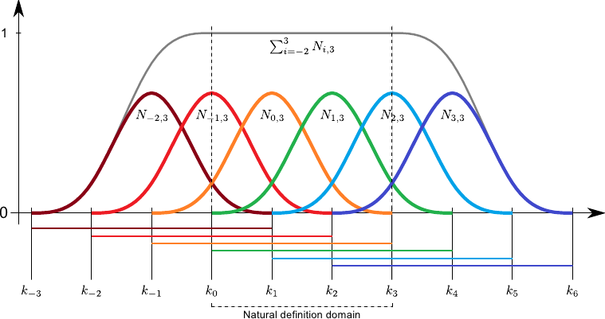
Radial Basis Functions
Basis Functions
[image from brnt.eu]
Notes:
a basis function is an element of a particular basis for a function space. Every continuous function in the function space can be represented as a linear combination of basis functions [wiki]
Allow one to define complex functions that wouldn’t be possible to express as say, a polynomial
This graph is a simple linear combinatuion of the colored functions. (which are Gaussian, a common basis function)

Slide 25
Radial Basis Functions
Basis Functions
Kernel Methods
Notes:
Kernel methods – what we’ve been talking about all class: they achieve flexibility by fitting simple models in a region local to the target point x_0.
COMBINE these for Radial Basis functions.

Slide 26
Radial Basis Functions
Notes:
This is how radial basis functions are expressed – note the similarity of the first line to what we’ve looked at earlier with localized kernels in general.
The difference here is obviously the prototype parameter Xi. Xi of j centers the parameter of j around a point, while lambda of j adjusts the scale

Slide 27
Radial Basis Functions
Notes:
Recall from earlier kernel smoothing discussion this relation/this alternative way of expressing the kernel.
Apply this to the model from the previous page and we get [next page]

Slide 28
Radial Basis Functions
Notes:
A popular choice for D is the standard Gaussian density function

Slide 29
Radial Basis Functions
Notes:
It would seem like a good idea to simplify this by making all lambda_j equal to one global lambda value, but this would have the side effect of creating holes in the resulting function, where none of the kernels has significant support. [see pic]

Slide 30
Radial Basis Functions
Notes:
You can get around the issue of holes with renormalized radial basis functions, as shown here. Note that the lamba is a single global value for all Xi_j.
H_j(x) captures each function’s contribution at every point with respect to the distance at that point from all other functions (based on those functions’ Xi parameters)

Slide 31
Radial Basis Functions
Notes:
And then you get the bottom graph here.

